Slide 1
USED CAR PRICE PREDICTION
Machine Learning
Presented by
Roshan Kumar Verma

Slide 2
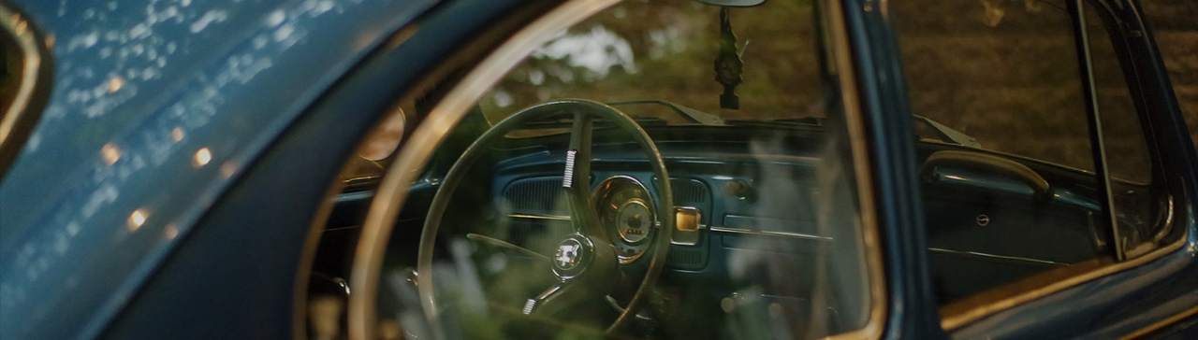
INTRODUCTION
With the Covid-19 impact in the market, we have seen lot of changes in the car market. Now some cars are in demand hence making them costly and some are not in demand hence cheaper. One of our clients works with small traders, who sell used cars. With the change in market due to covid 19 impact, our client is facing problems with their previous car price valuation machine learning models. So, they are looking for new machine learning models from new data. We have to make car price valuation model.

Slide 3
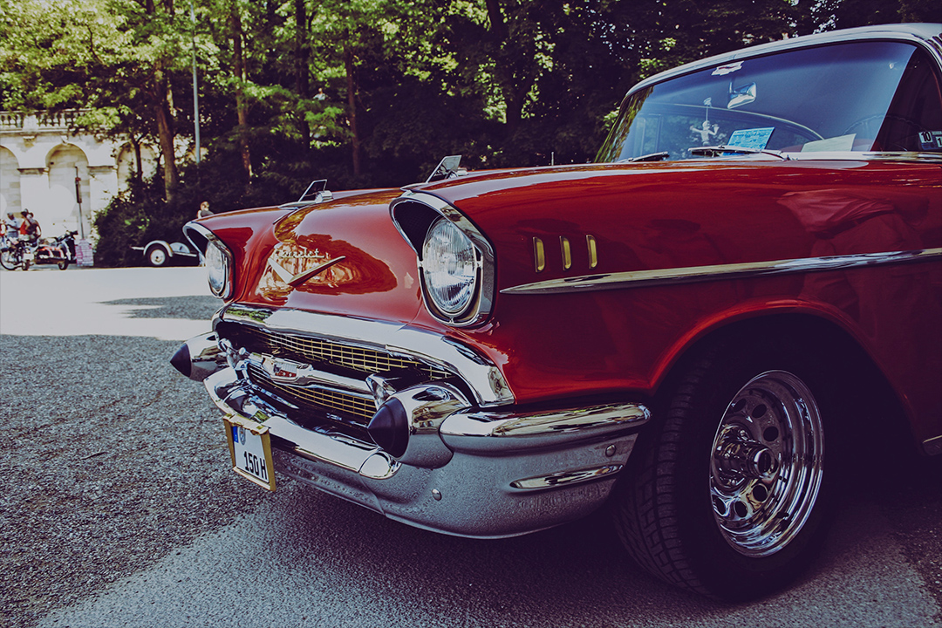
Business Problem
The Indian automotive sector was already struggling before the Covid-19 crisis but situation was worsened by the onset of the Covid-19 pandemic and the ongoing lockdowns across India and the rest of the world .
Auto sector has been under pressure due to a mix of demand and supply factors . There are two positive developments emanating from COVID-19. The China supply chain shock is forcing major investments in the “Make in India” initiative. The COVID-19 crisis has exposed chinks in the automobile business model and it could cause a big move towards electric vehicles (EVs). That could be the big positive for auto sector.

Slide 4
Data Sources and their formats
The Data is scrubbed on multiple ecommerce websites that sells used cars in India, Websites like cars 24, OLX and car Dekho. These data are scrubbed and stored in a CSV format. Data contains following columns.After the pre-processing of the data that is collected, I have split the data as x_1 and y_1 and I have imported the required libraries to train my model.
'MNF_YEAR' – At what year the car is manufactured
'BRAND' – Brand is manufacturer or which company made
'MODEL' – It is basically the model of the car.
'VARIANT' – Gear shift variant is (Automatic, Manual, Semi-Automatic)
'DRIVEN_KM' – no of Kms driven before selling
'FUELTYPE' – Petrol, diesel, CNG, LPG, Electric
'NOOF_OWNERS' – 1end, 2end or 3end car
'PRICE' – our target variable that tells what is the price of the used car.
Now it our all columns are of Dtype are of "int32" , and we do not have any NULL values .
Hence we can see that our data is proper and ready for ML Models

Slide 5
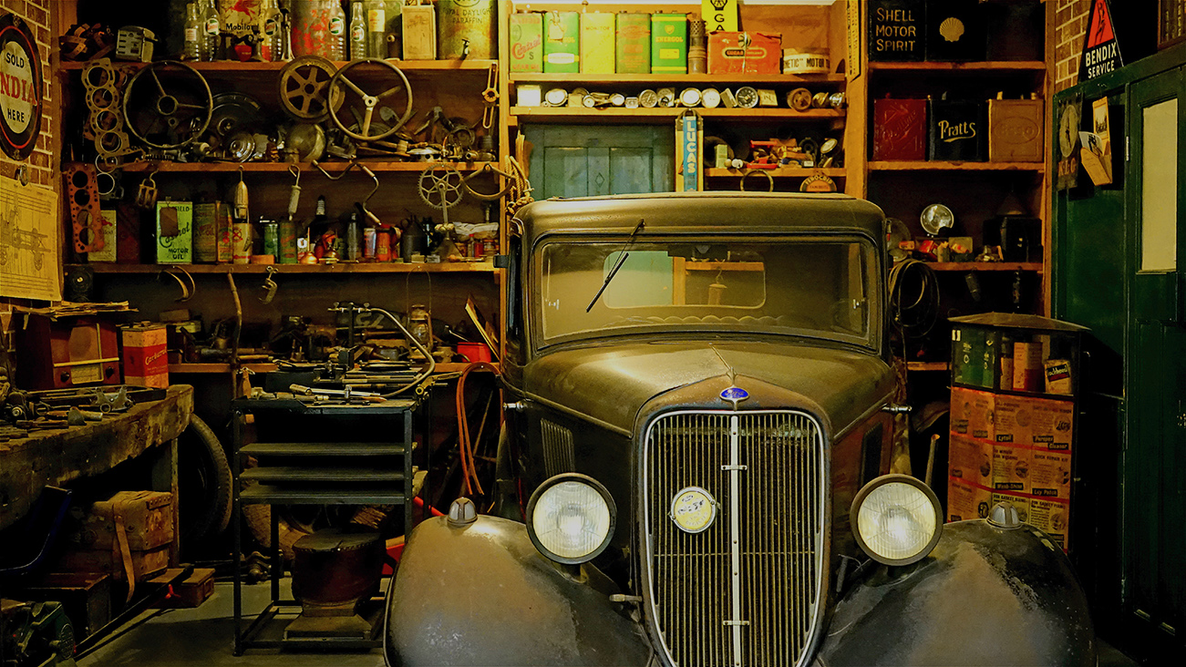
EDA
On data cleansing I have detecting duplicate records in the data collected and the null values in the data.
We have 359 null values in Variant column, I have used those null values in the model building but I have changed null values as not mentioned, this will also help the client to predict the values on the used cars without the Variant values.
On importing the data that is collected I have done some initial play around to understand the data and to cleanse the data.

Slide 6
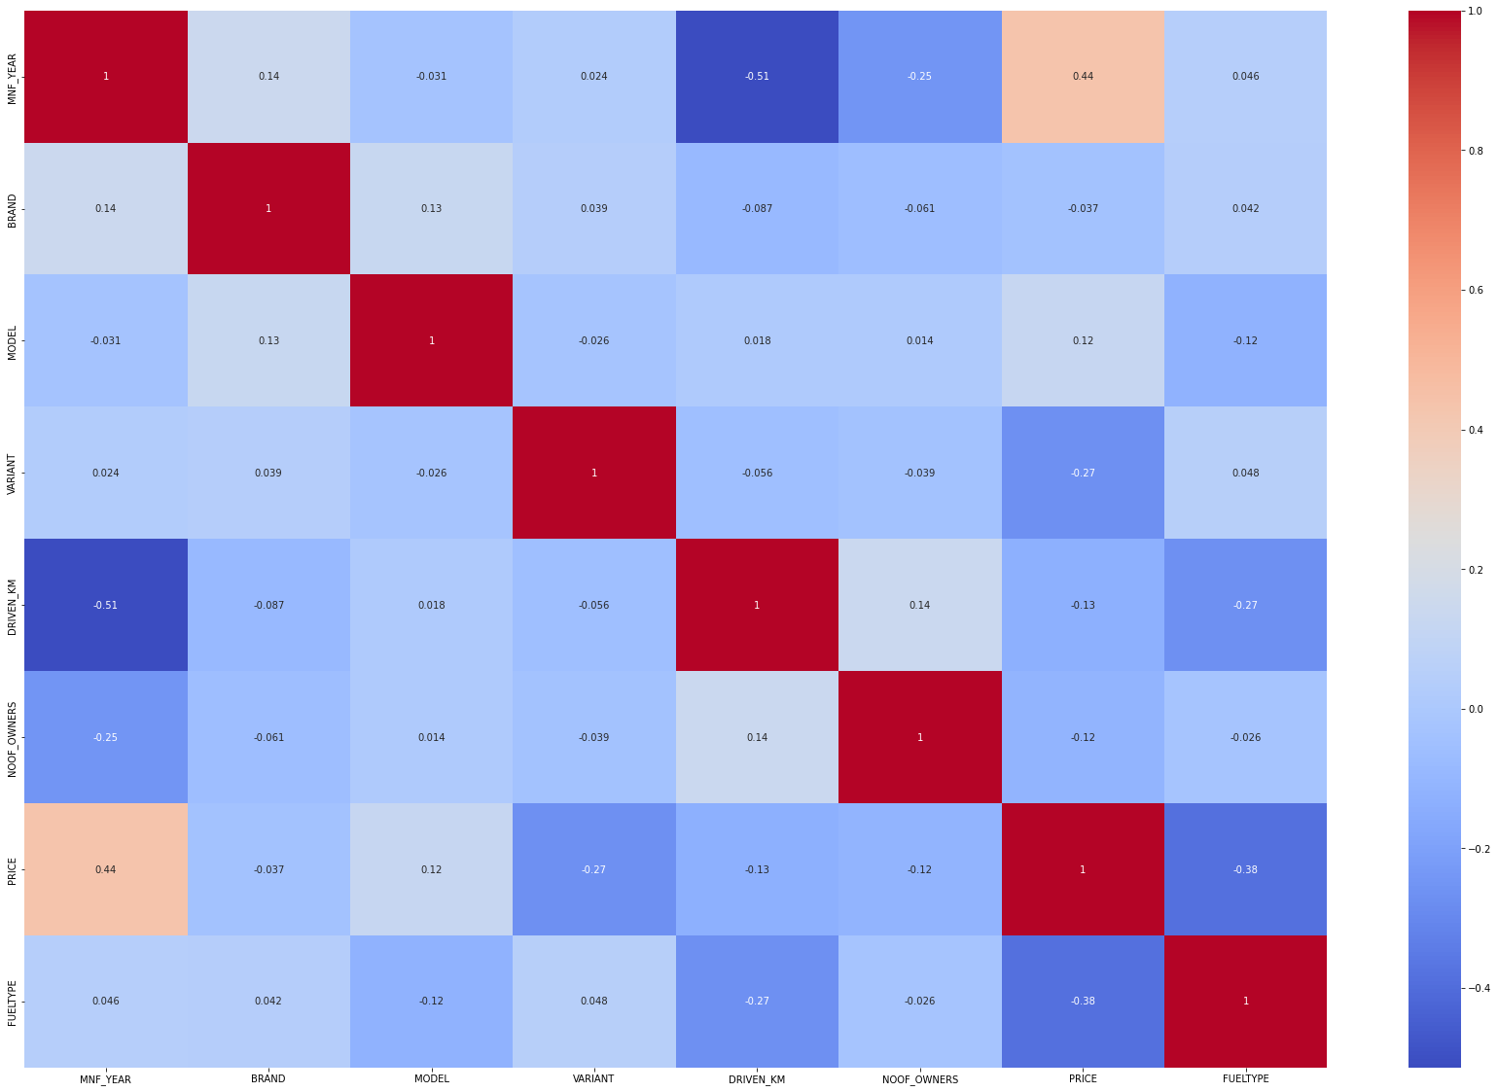
Correlation of the Data

Slide 7
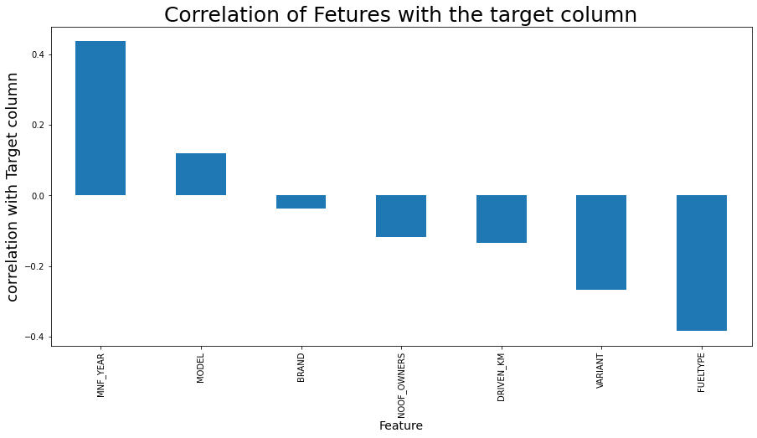
Correlation of Features with the target column
From above we can clearly see that MNF_YEAR is positively correlated to PRICE.
Whereas, FUEL_TYPE and VARIENT is negative correlated to PRICE .

Slide 8
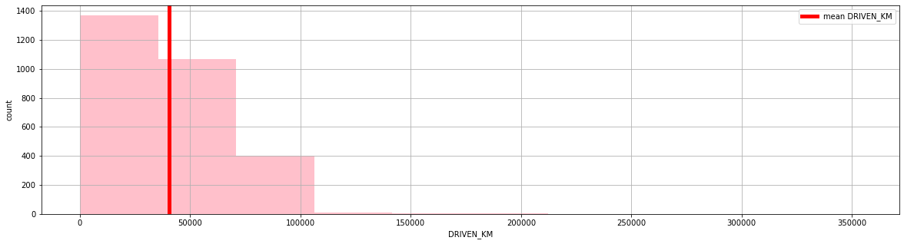
Relation of Price with Driven KM
Mean of the DRIVEN_KM is 40604.47kms and the maximum KMS driven is 353693.00kms.
Above we can understand that most of the Car comes to sellimg around low kilometers driven.

Slide 9
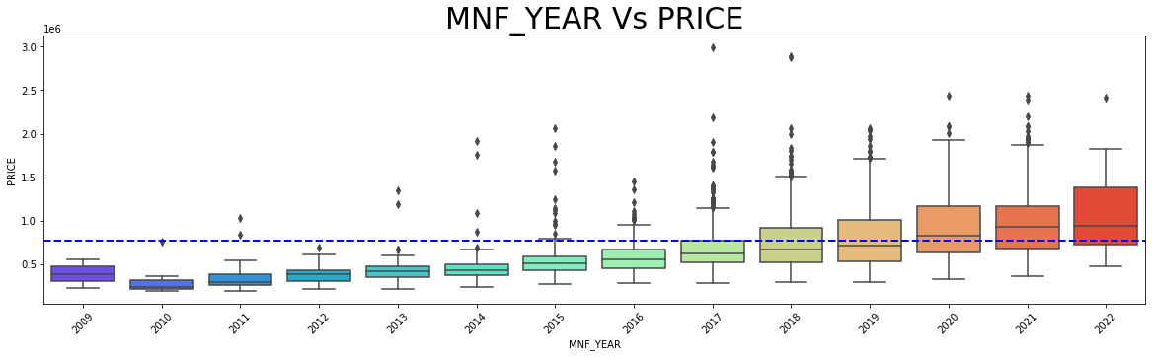
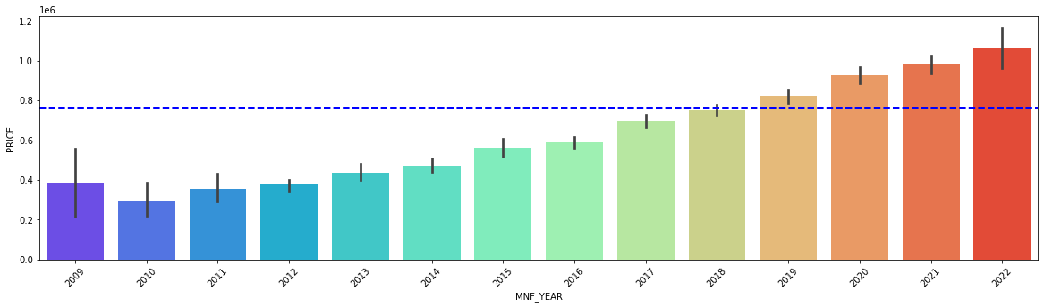
Relation of Price with MNF_YEAR
2019, 2020, 2021 , 2022 model are being sold higher in PRICE and also above average PRICE.

Slide 10
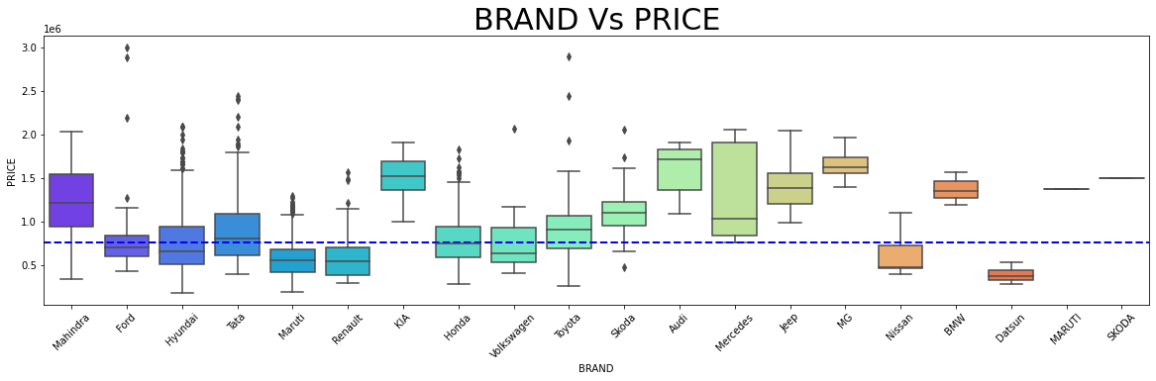
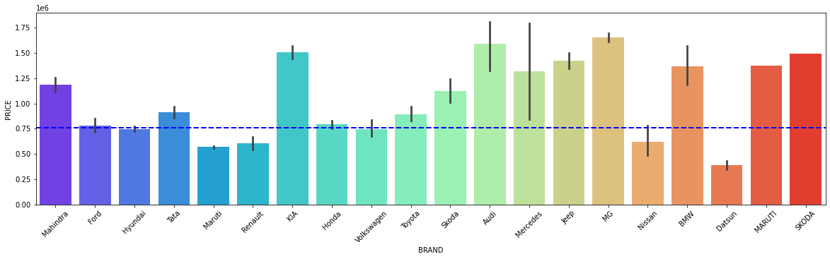
Relation of Price with BRAND
When comes to the Brand MG and Audi are being the costliest in country followed by the likes of BMW , KIA , Jeep etc .

Slide 11
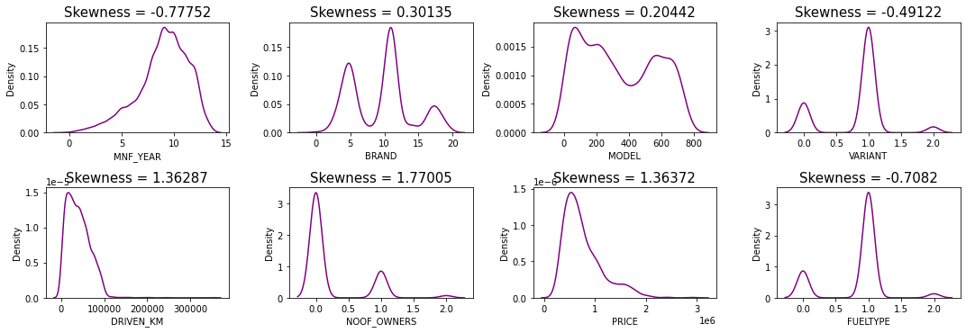
Skewness
Viewing the Skewness of the Data

Slide 12
Model Building
Considering the business requirement of the client, I have collected the precise data to predict the used car price but there where multiple data of the car that are available. Data like colour of the car, sun roof attached, music system brand, electronics in the car, tyre brands, seat colours and much more. But after analysing all these data I have selected the data that have more correlation with the price of the car. Data like manufacturing year, number of owners used before, mode, fuel variant, gear shift variant, Brand of the car. I experimented and visualized how these variables contributed more towards the deciding factor of the car price. Based on such visualization I have built the model.
After the pre-processing of the data that is collected, I have split the data as x_1 and y_1 and I have imported the required libraries to train my model.
On selecting the best random state parameter, I have used nine regression algorithms to train my model. Based on the best model score and best CV score I have selected Random Forest Regressor as the final model.
I have used nine different regression algorithms to shortlist the best model.
Best model was chosen on comparing all Cross validation mean score and the model score.

Slide 13
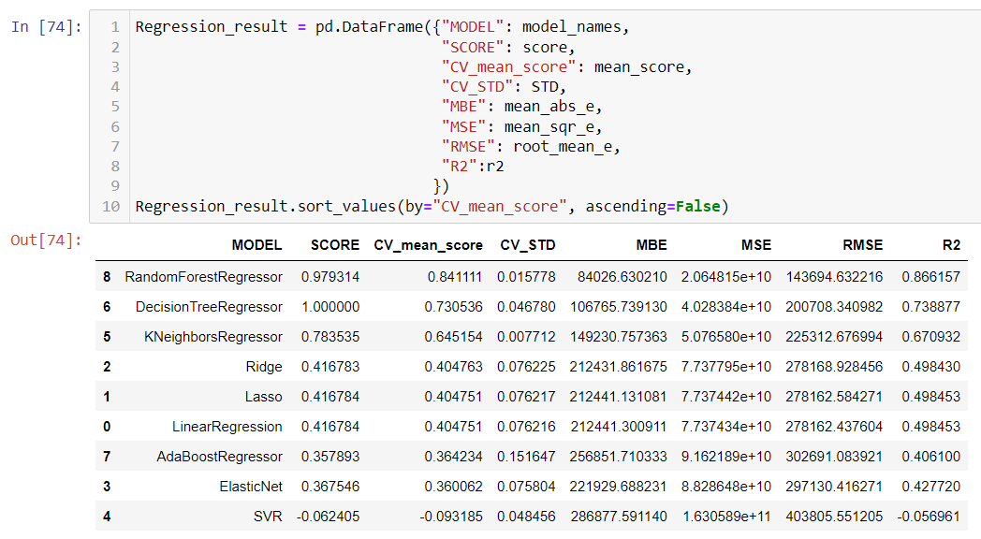
From above observation, we can come to a conclusion that Randomforest is the best model with Score of 98.78 lets try in Hyper tuning the same for improved performance and also to reduce the over fitting the Data.

Slide 14
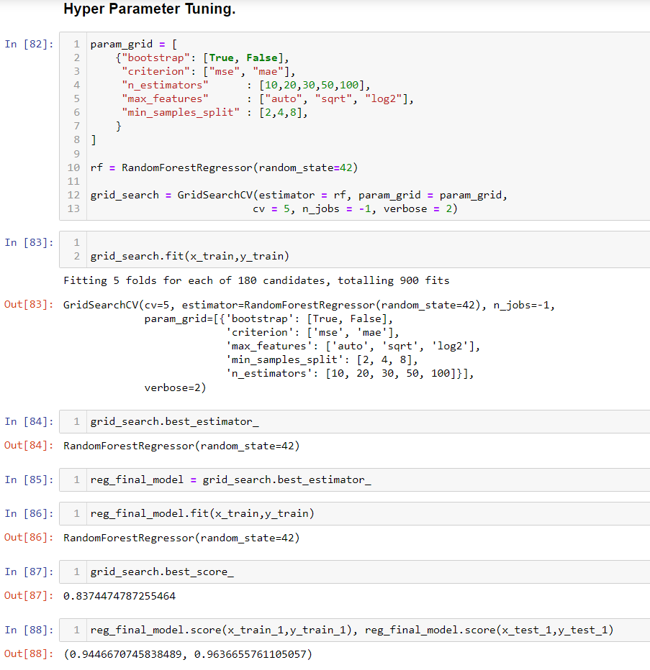
Hyper Parameter Tuning
We have Hyper parameter tuned the model and improved the model score up to 94% with the Grid search cv score of 83.70%

Slide 15
Conclusion
The manufacturer like Land Rover, Benz, BMW cars are costliest used car in the market comparatively to other cars, the low kilometres driven and also if the manufacturing year is lesser on these brands those card sells in much higher rates or closest to the buying new car rates. The Diesel variant and Automatic shift variants are also costliest user car variants in the used car market.
Key Findings and Limitations
The above research will help our client to study about the latest used car market and with the help of the model built he can easily predict the price ranges of the cars, and also will helps him to understand based on what factors the Car Price is decided.
The limitation of the study is that in the volatile changing market we have taken the data, to be more precise we have taken the data at the time of pandemic, so when the pandemic ends the market correction might happen slowly. So based on that again the deciding factors of the used car prize might change and we have shortlisted and taken these data from the important cities across India, if the seller is from the different city our model might fail to predict the accurate prize of that used car.

Slide 16
Thank You!

